Slide 1
ME 233 Advanced Control II Lecture 14 Frequency-Shaped Linear Quadratic Regulator
(ME233 Class Notes pp.FSLQ1-FSLQ5)
TexPoint fonts used in EMF.
Read the TexPoint manual before you delete this box.: AAAAAAAA

Slide 2
Outline
Parseval’s theorem
Frequency-shaped LQR
Implementation
Frequency-shaped LQR with reference input

Slide 3
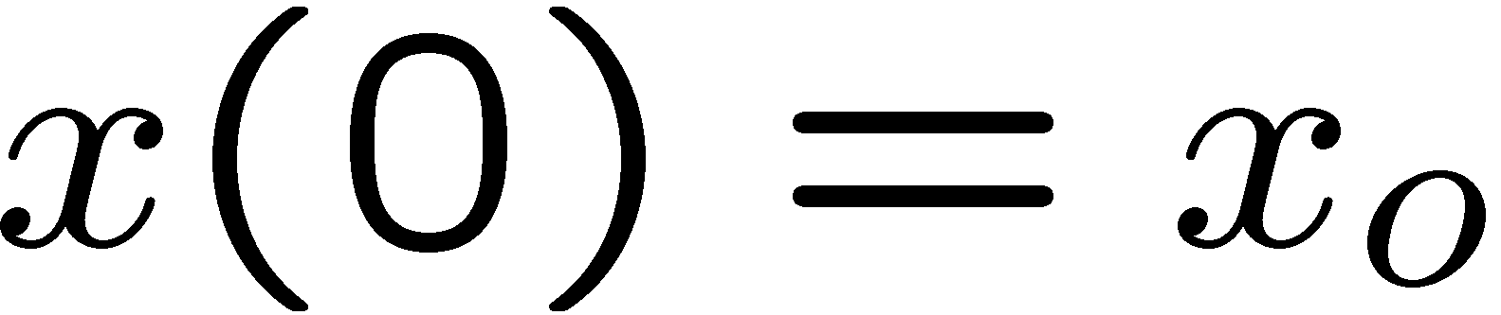
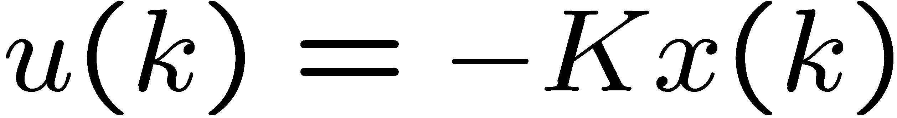
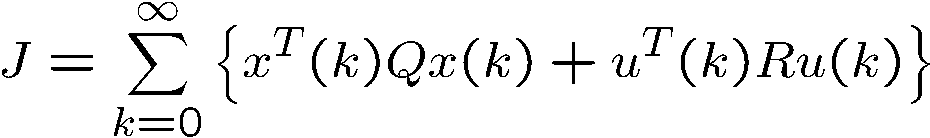
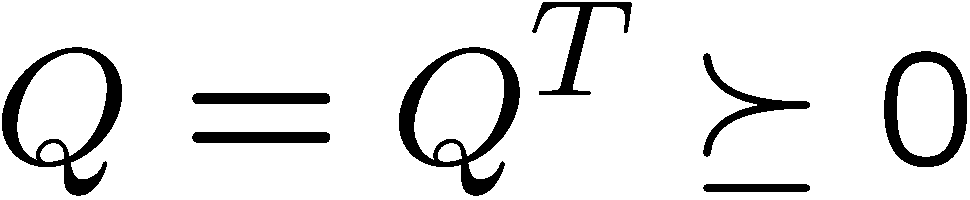
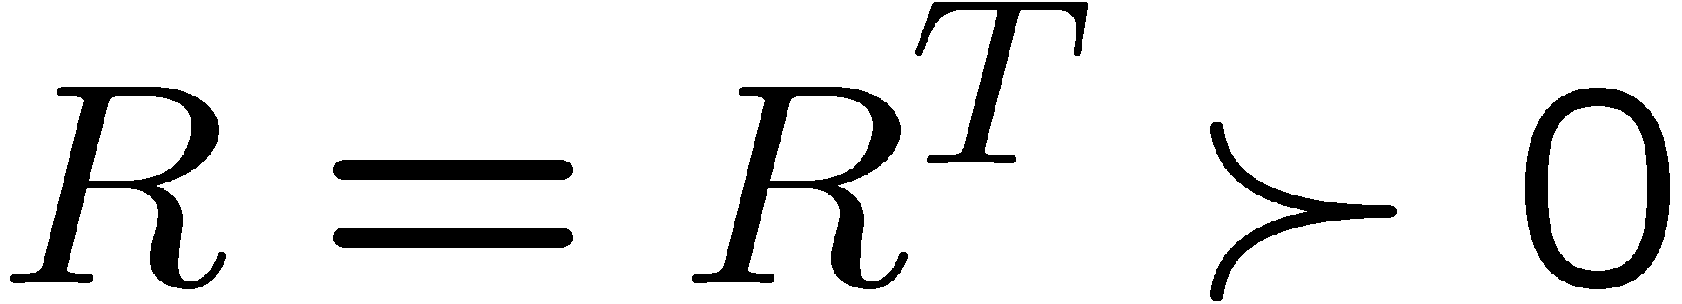
Infinite-Horizon LQR (review)
nth order LTI system:
Find the optimal control:
which minimizes the cost functional:

Slide 4
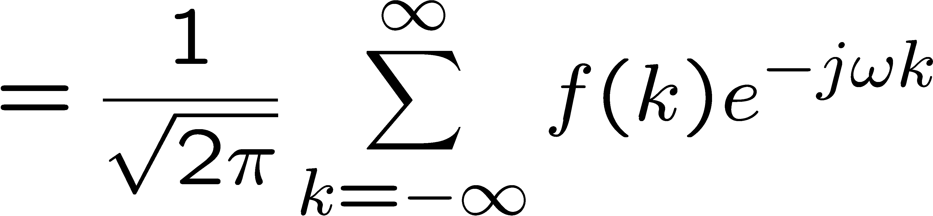
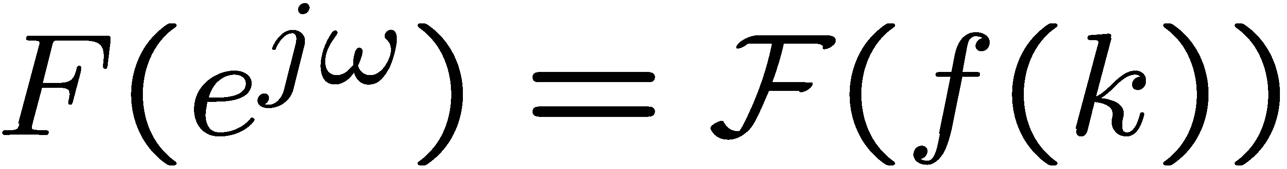
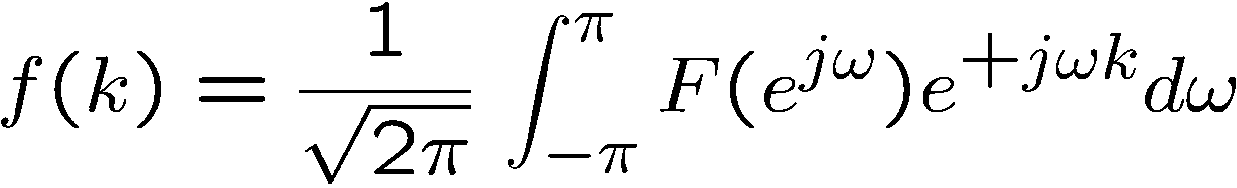
Parseval’s theorem
Let f(k) be a map from the integers to
Its (symmetric) Fourier transform is defined by
and

Slide 5
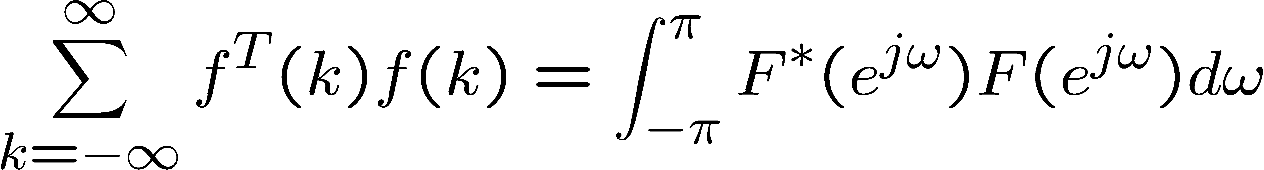
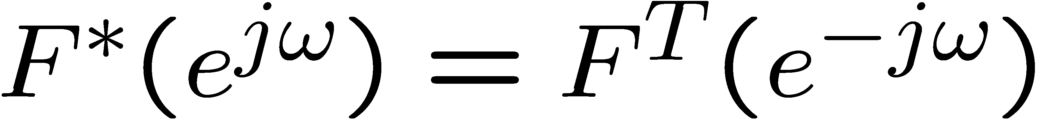
Parseval’s theorem
where
(complex conjugate transpose)

Slide 6
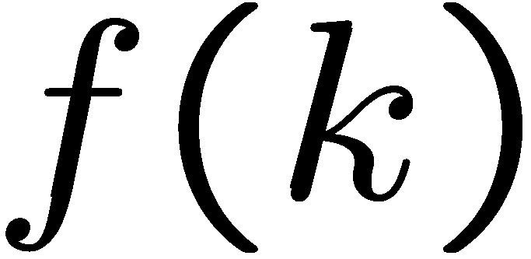
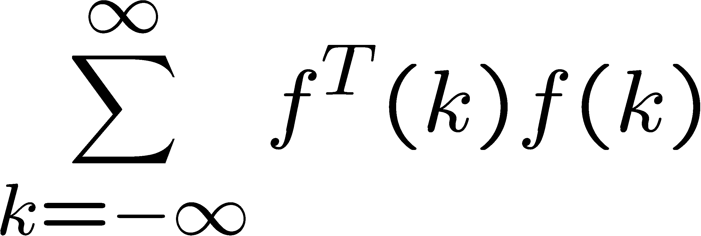
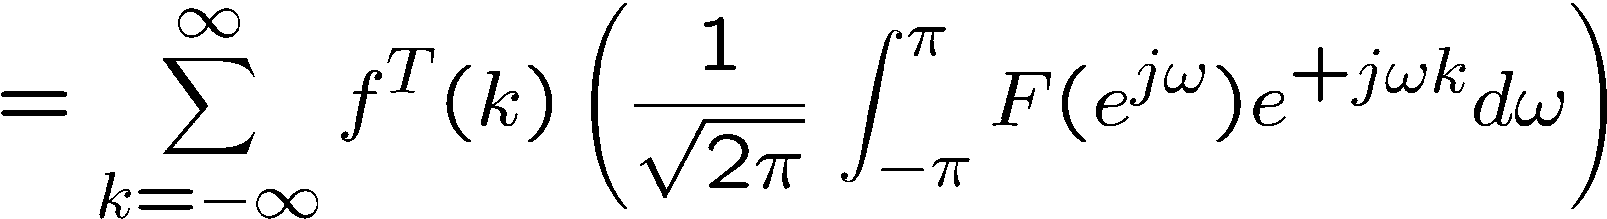
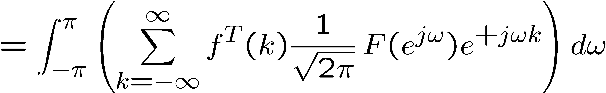
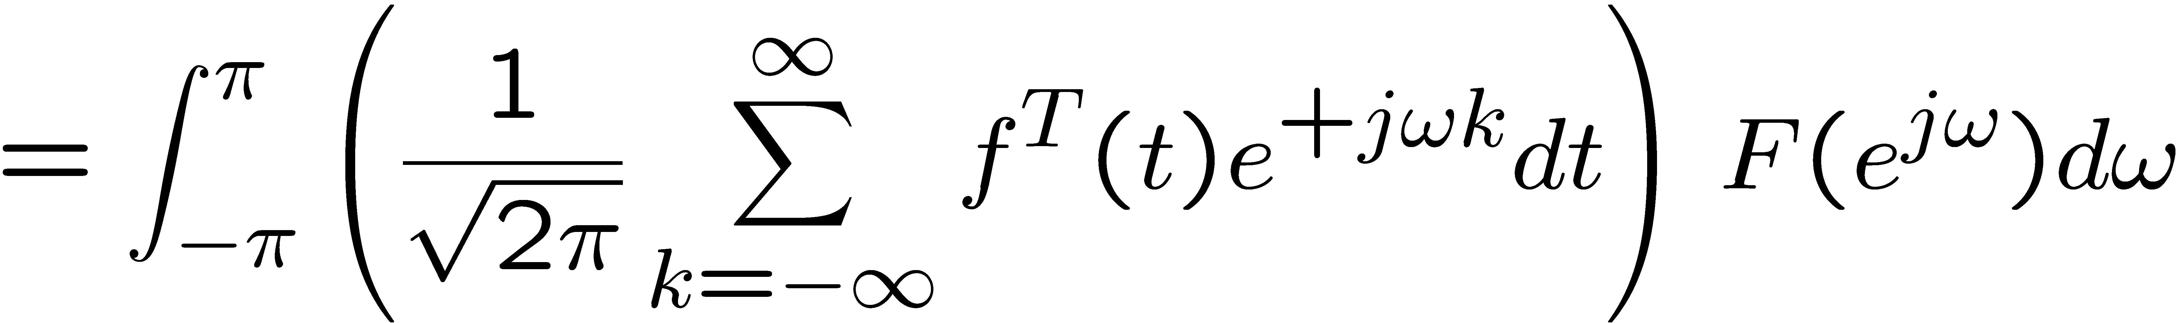

Proof:

Slide 7


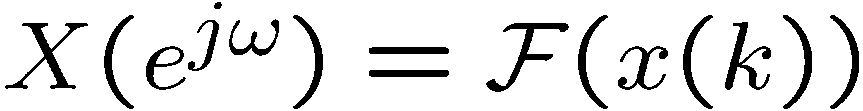
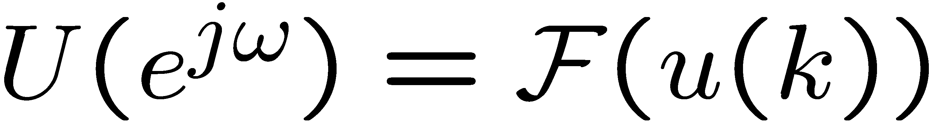
Frequency Cost Function
By Parseval’s theorem, the cost function:
with
is equivalent to the cost function

Slide 8
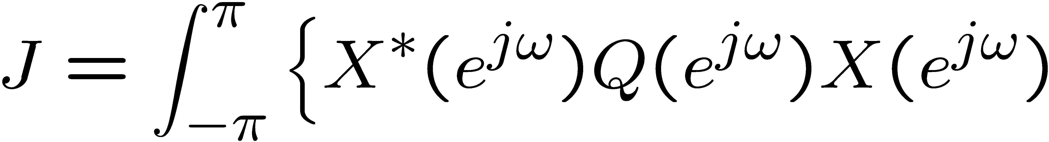
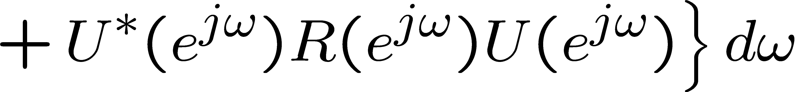
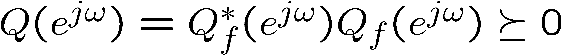
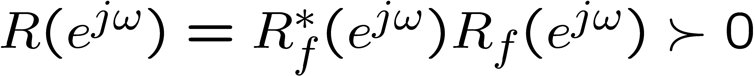
Frequency-Shaped Cost Function
Key idea: Make matrices Q and R
functions of frequency
where

Slide 9
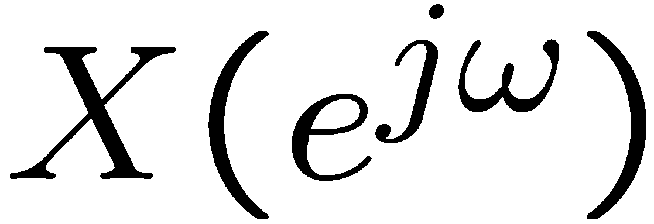
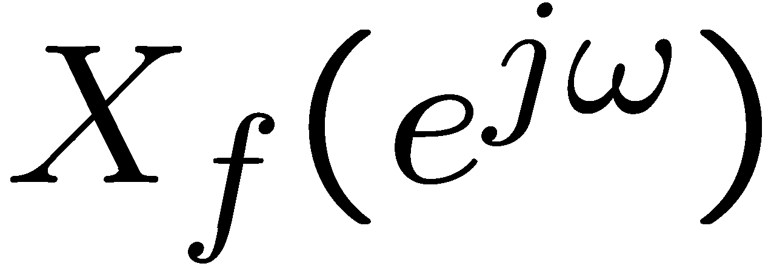
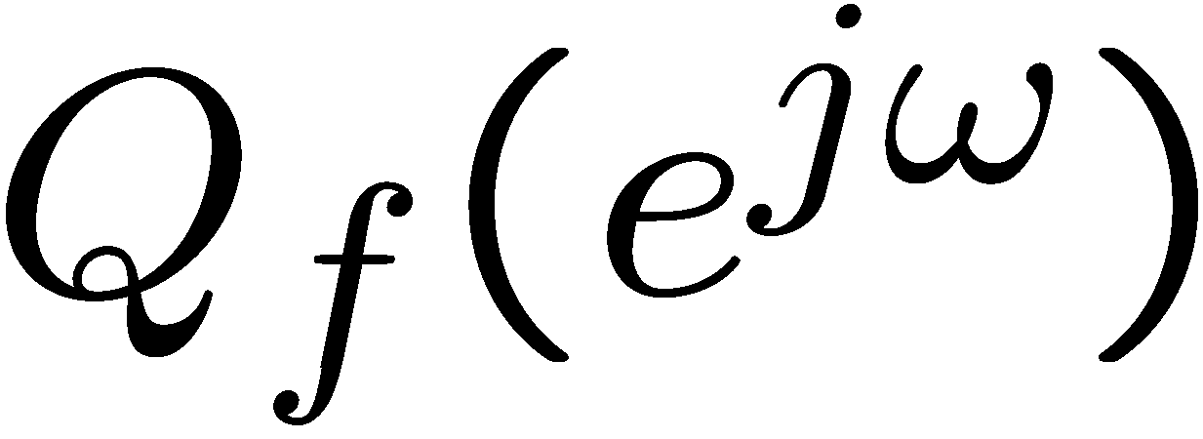

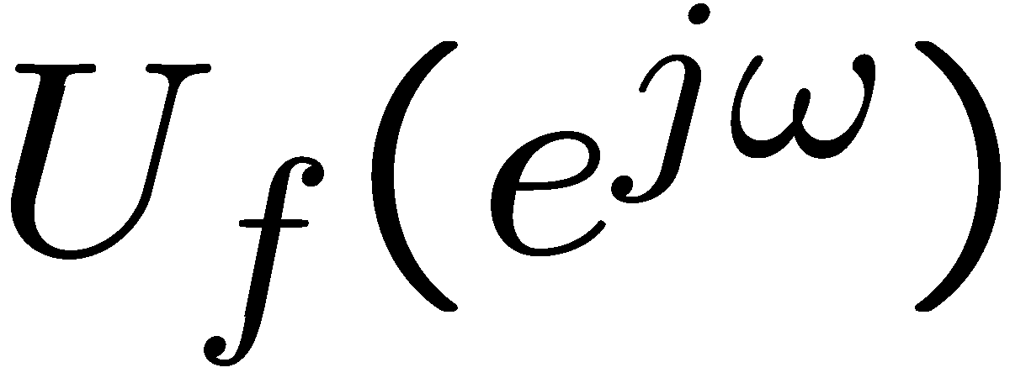
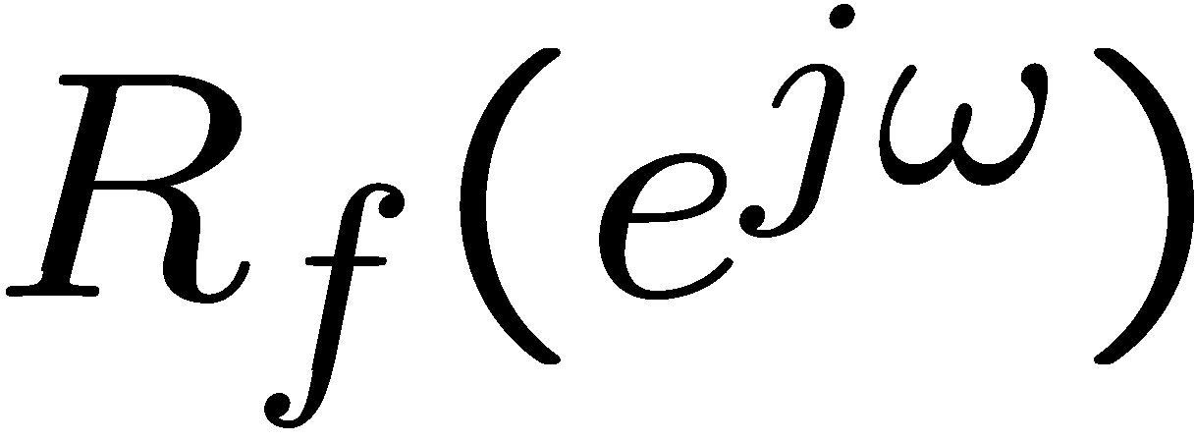
Frequency-Shaped Cost Function
Define the state and input filters
state filter
input filter

Slide 10
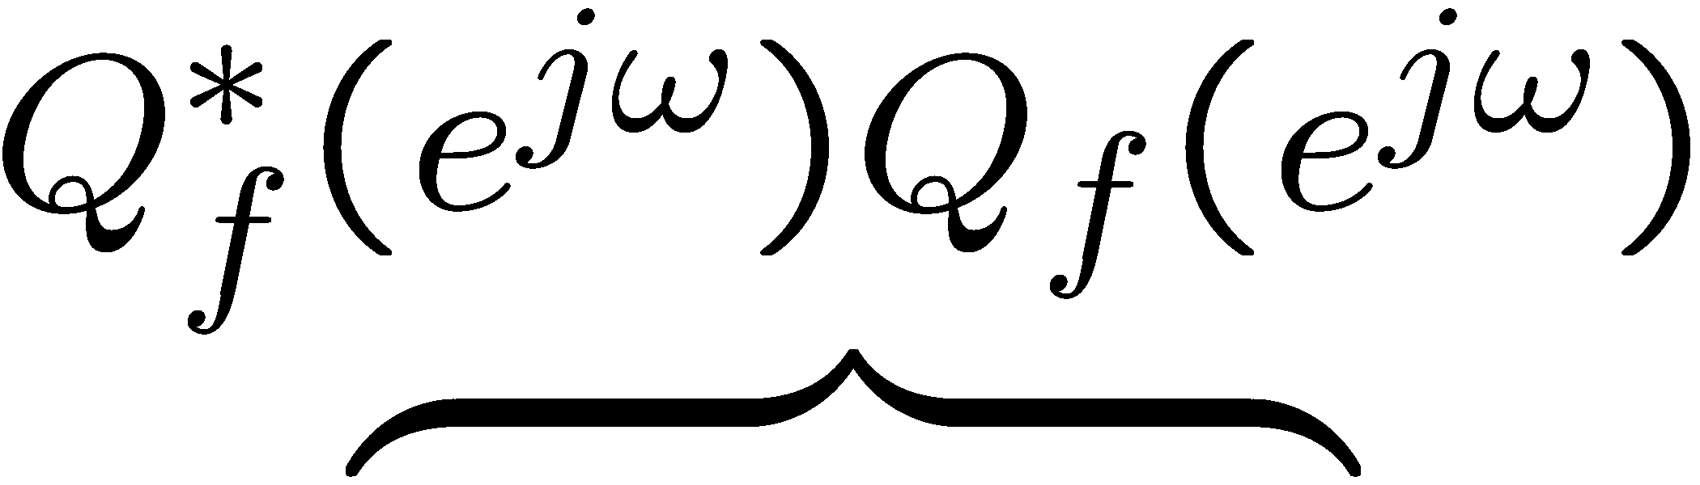

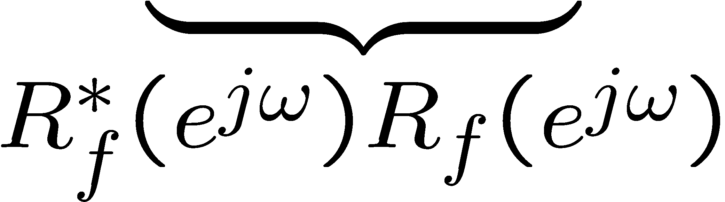
Frequency-Shaped Cost Function
can be written

Slide 11
Realizing the filters using LTI’s
Let
be realized by
so that
is causal or strictly causal.

Slide 12
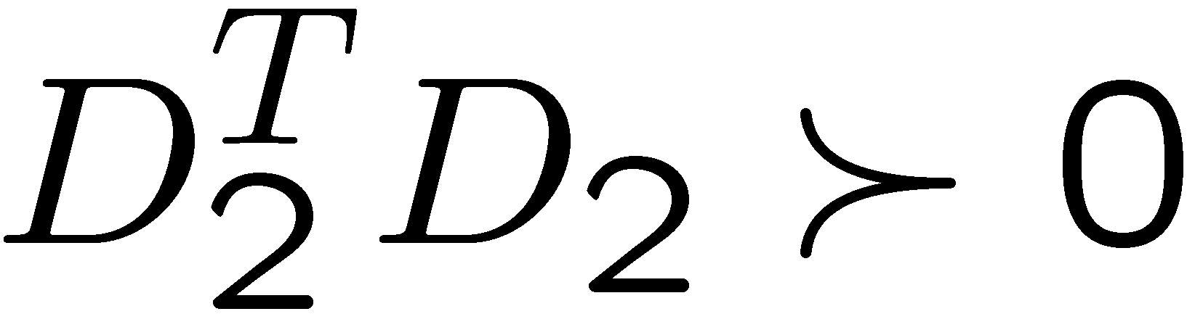
Realizing the filters using LTI’s
Let
be realized by
(with ) so that
is causal (but not strictly causal)

Slide 13
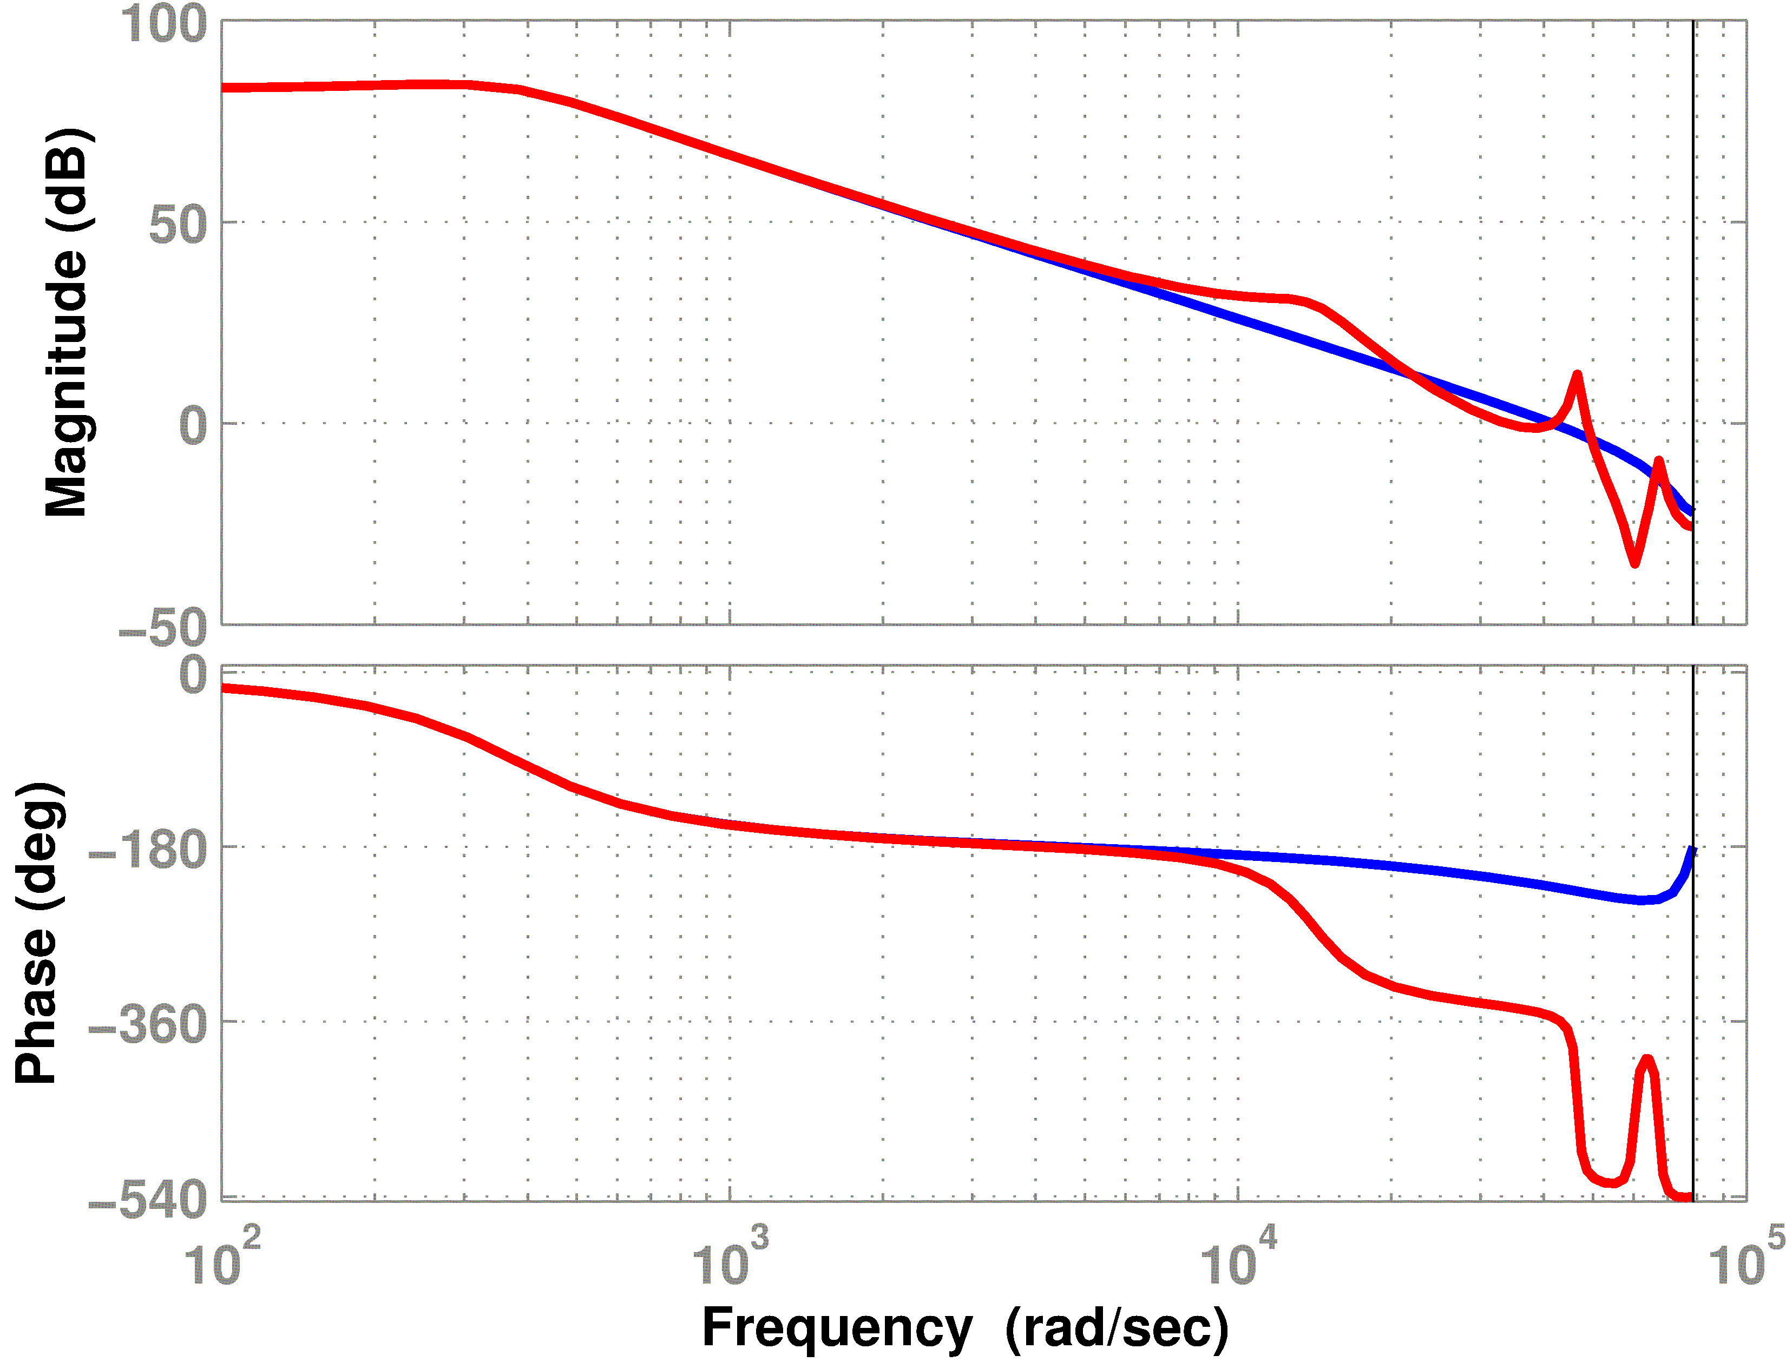



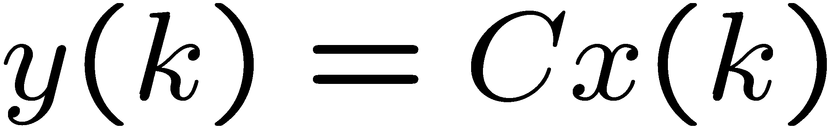
Example: Hard Disk Drive
Consider a simplified model of a voice coil motor and suspension
(from control input u(k) to read/write head position y(k))
uncertainty
nominal model
actual plant
high-frequency resonance
modes are neglected in the
nominal model

Slide 14
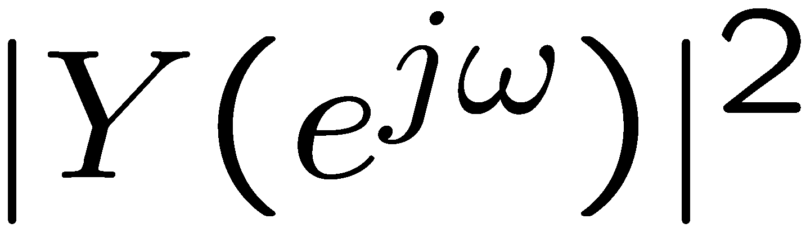
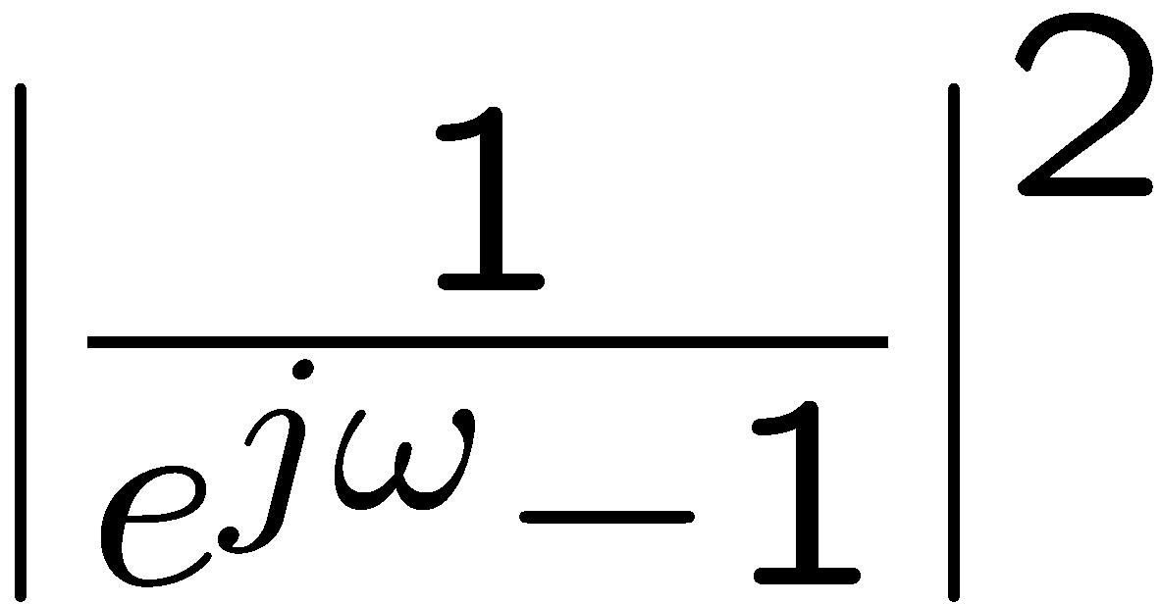
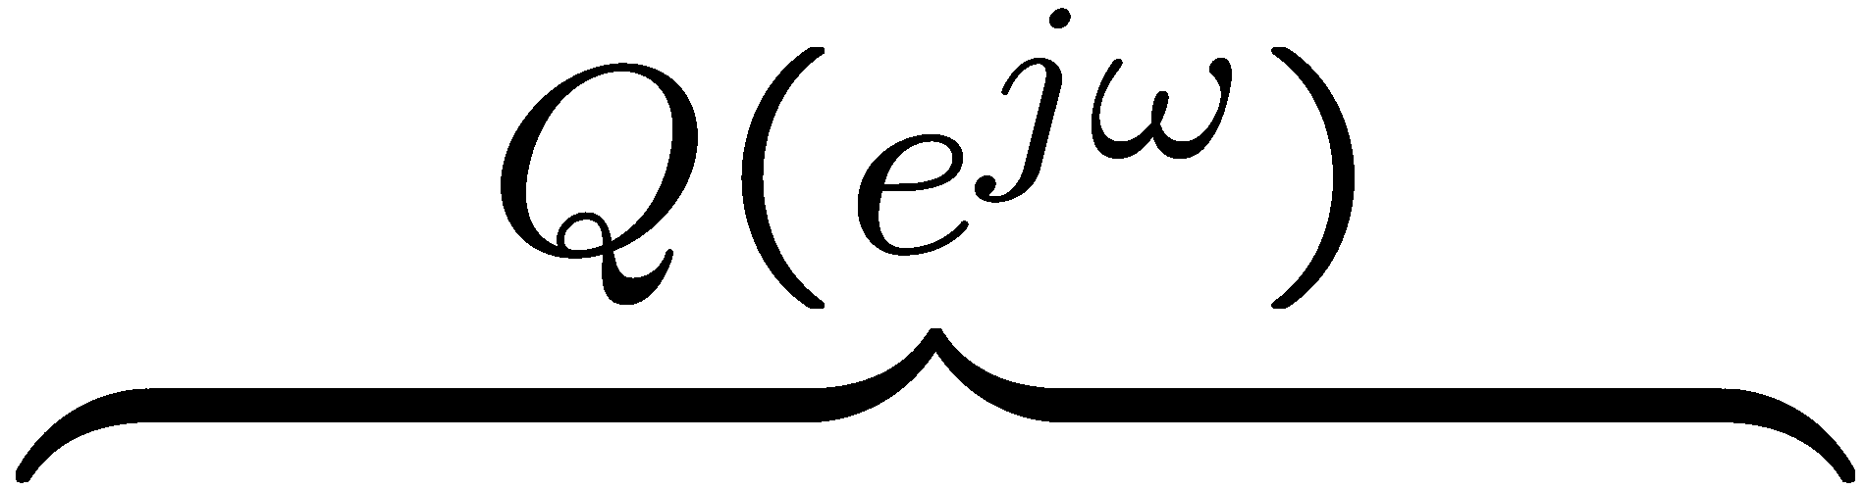
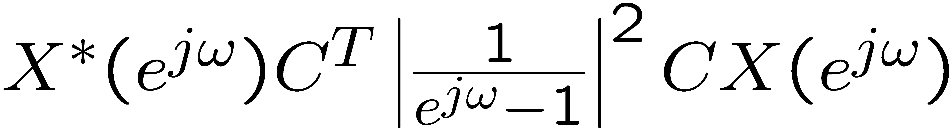
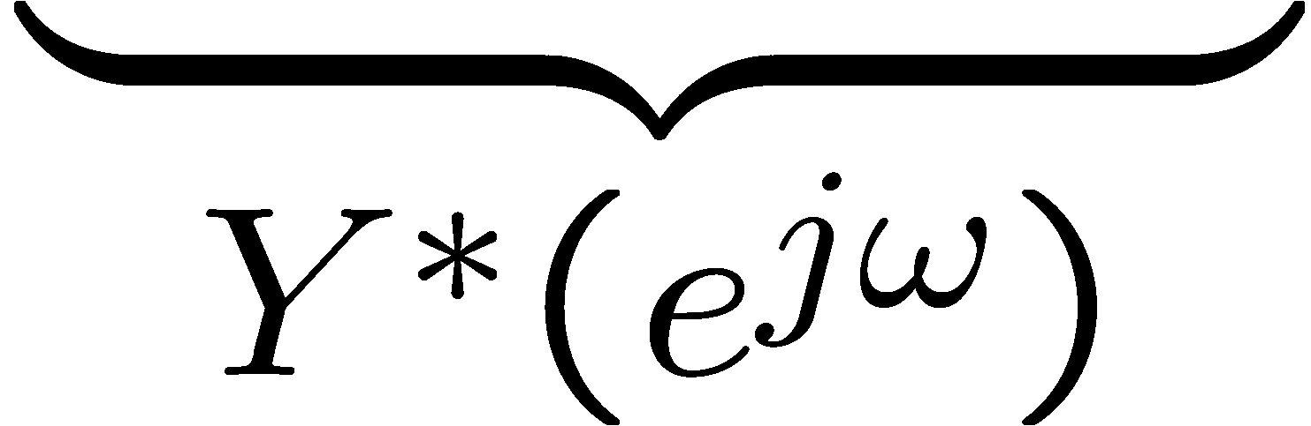
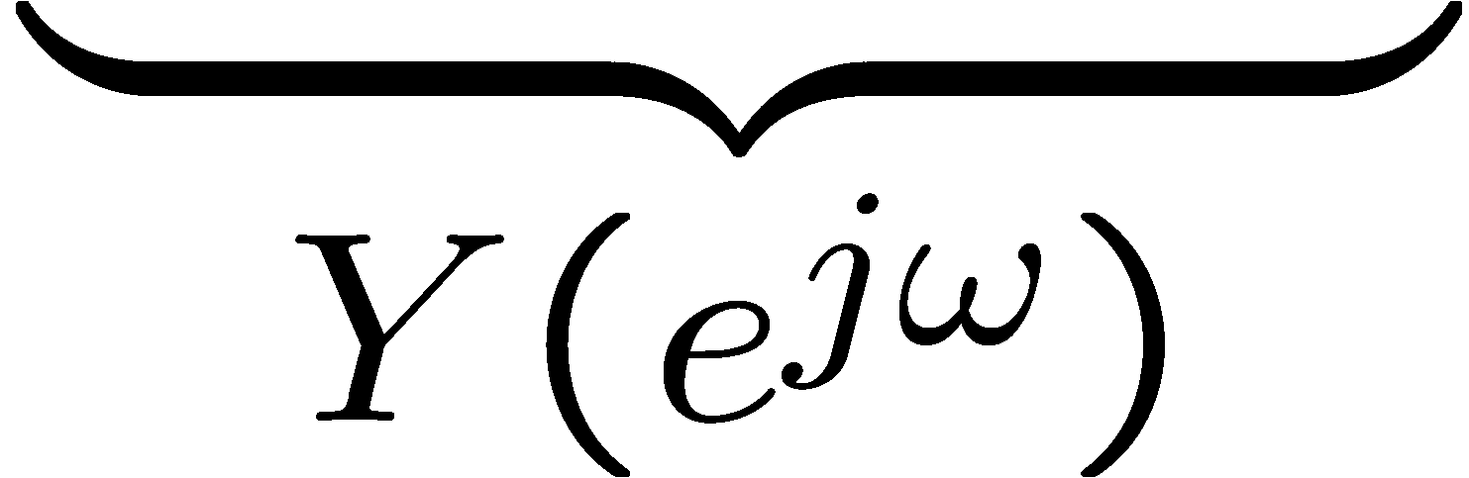
Example: Frequency State Weight Q(jω)
we want zero steady state (i.e. dc)
error under a step input
set position cost function weight
to go to ∞ as ω → 0
Example
Set weight on to

Slide 15
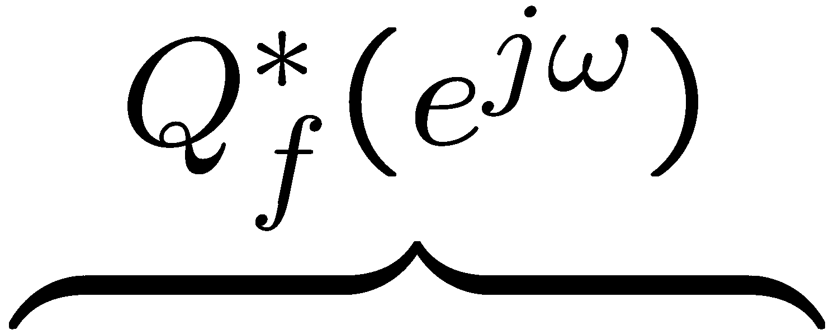
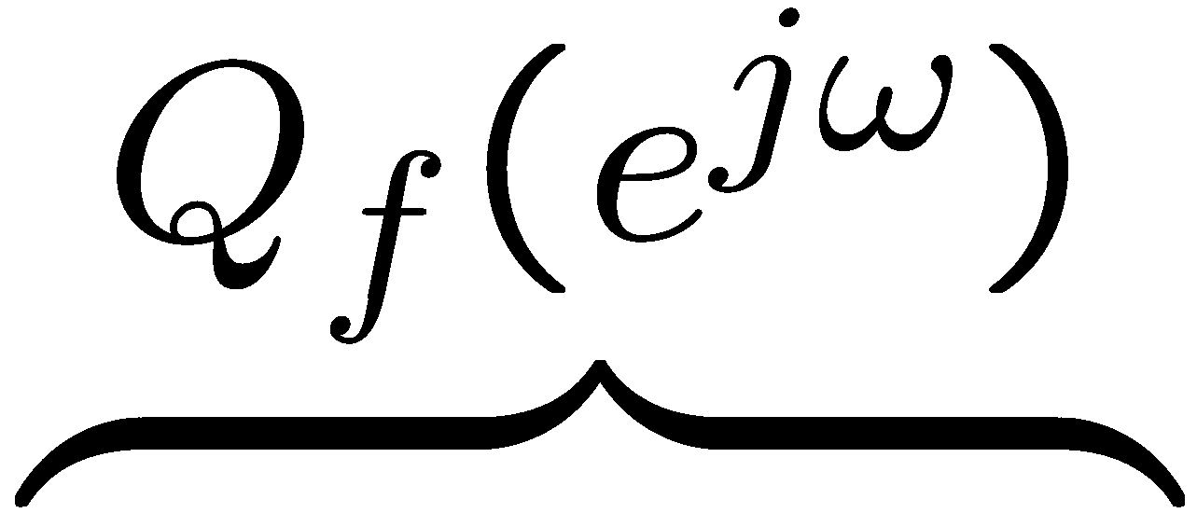
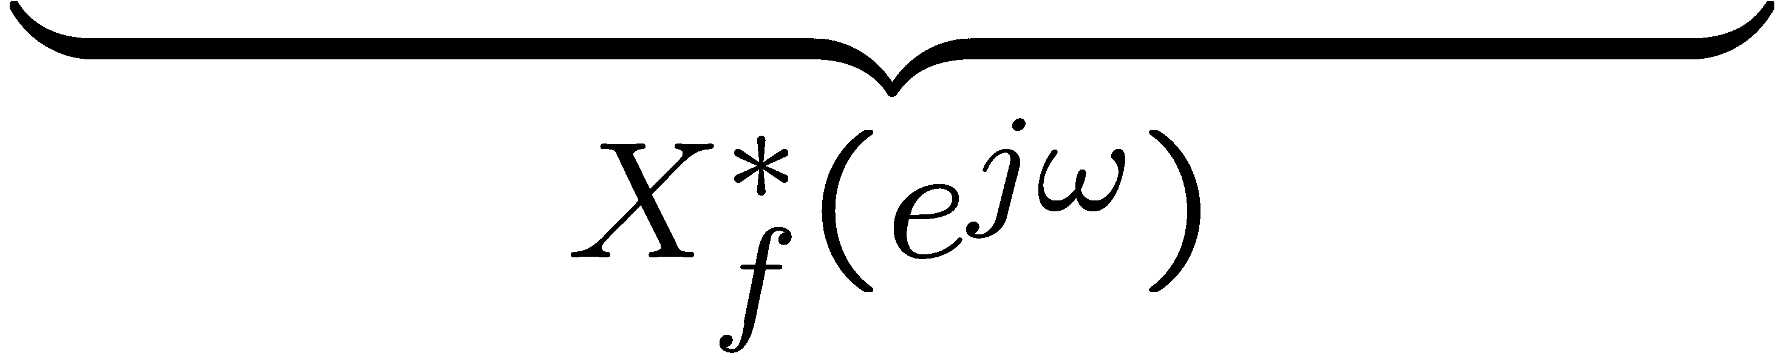
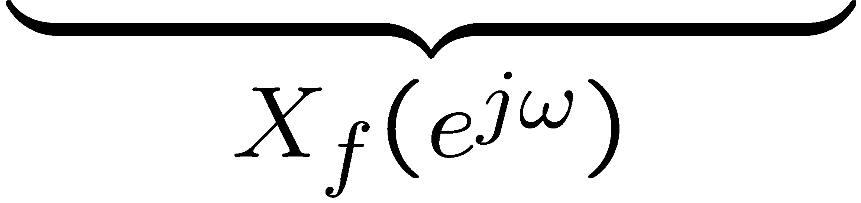
Example: Frequency State Weight Q(jω)
we want zero steady state (i.e. dc)
error under a step input
set position cost function weight
to go to ∞ as ω → 0
Example

Slide 16
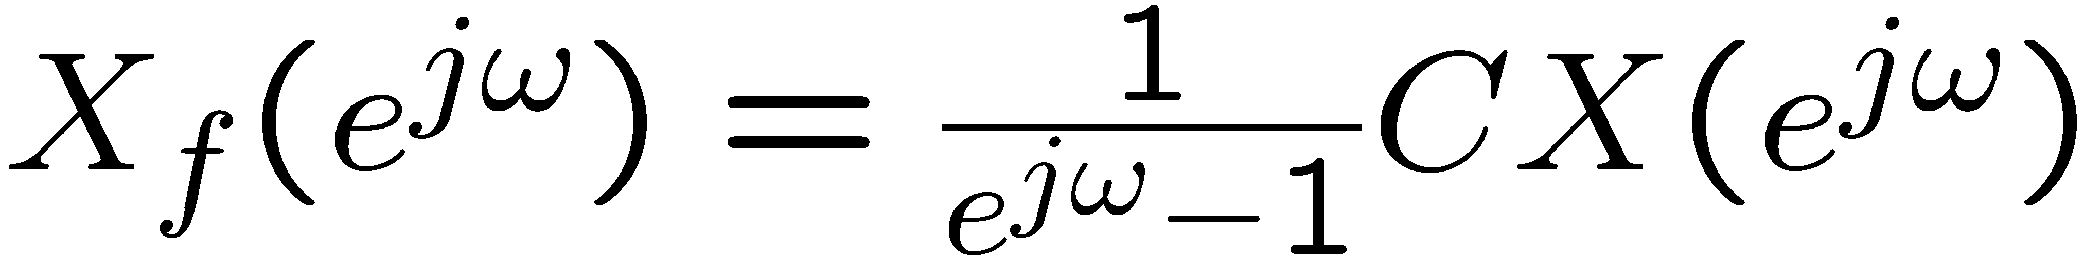
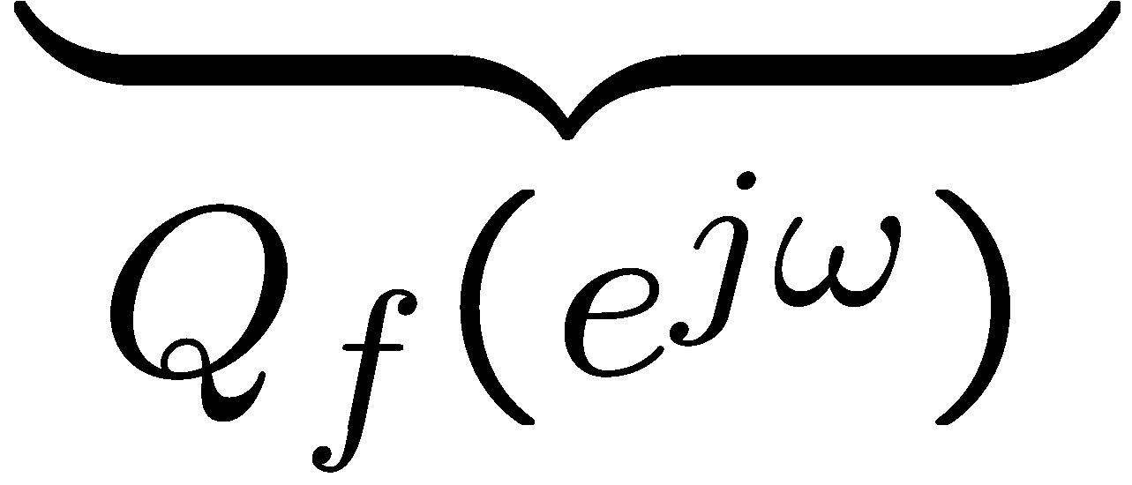


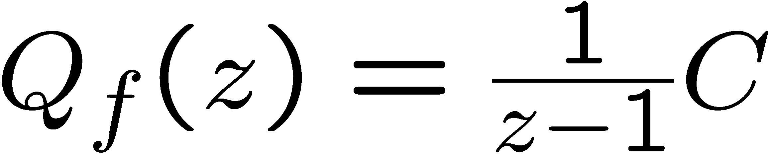
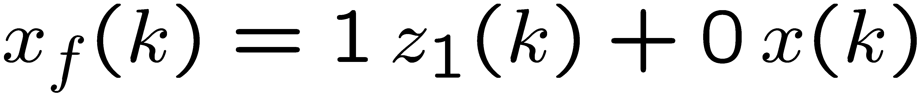


Example: Frequency State Weight Q(jω)
state space realization
Example
state space realization

Slide 17
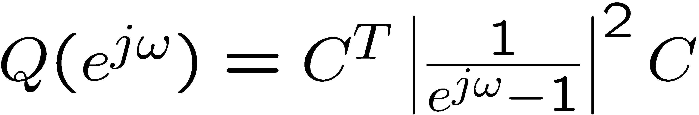
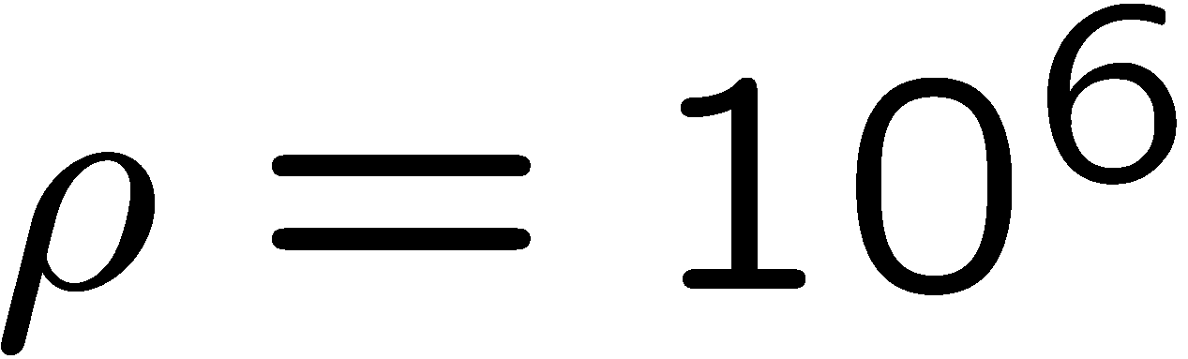






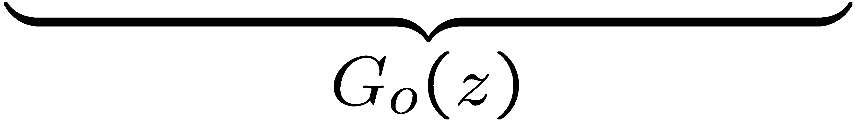
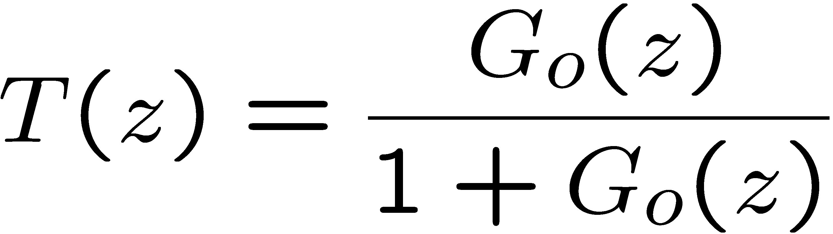
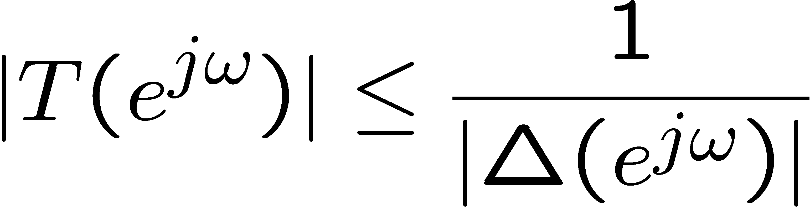
Example: Hard Disk Drive
Apply control design
to nominal model
Weights:
FS-LQR is a dynamic
state feedback
+
-
Sufficient condition for robustness
(by small gain theorem) :

Slide 18










Example: Hard Disk Drive
Weights:
+
-
sufficient condition for robustness
(by small gain theorem) :
potential
lack of robustness

Slide 19


Example: Frequency Control Weight R(jω)
increase control penalty
at high-frequencies
Example

Slide 20




Example: Frequency Control Weight R(jω)
Example
Discretize using ZOH

Slide 21

Example: Frequency Control Weight R(jω)
Example
+
-
Robustness condition is satisfied

Slide 22

Cost Function Realization

Slide 23



Cost Function Realization
where
state space realization
state space realization

Slide 24

Cost Function Realization
Plus:
define extended state

Slide 25




Cost Function Realization
We can combine state equations and output as follows:

Slide 26




Extended System Dynamics

Slide 27



Extended System Cost
Using
the cost can be expressed

Slide 28
FSLQR problem statement
Minimize
Subject to
This is a standard LQR problem!

Slide 29



FSLQR solution
The optimal control law is
where P is the solution of the DARE
for which is Schur

Slide 30
FSLQR existence
The optimal control law exists if
(A_{e}, B_{e}) stabilizable
The state-space realization C_{e}(zI-A_{e})⁻¹B_{e} + D_{e} has no transmission zeros on the unit circle

Slide 31




Sufficient conditions for FSLQR
The optimal control law exists if the following hold:
(A,B) is stabilizable
Q_{f} and R_{f} are stable (i.e. A₁ and A₂ are Schur)
whenever
whenever
(You will be asked to show this for homework)

Slide 32

Remarks on existence conditions
Condition 3 from the existence conditions:
whenever
is equivalent to the condition that
The state space realization for R_{f} has no transmission zeros on the unit circle
(This is because )

Slide 33
Remarks on existence conditions
Condition 4 from the existence conditions
whenever
is a stronger version of the condition that
None of the unit circle eigenvalues of A are transmission zeros of the state space realization for Q_{f}
(The latter is not enough for FSLQR existence)

Slide 34


Implementation
Control

Slide 35




















Block Diagram
0

Slide 36
Equivalent Block Diagram
0
+
-

Slide 37

State-space realization for K(z)

Slide 38




FSLQR with reference input
For simplicity, we will assume a scalar output
Assume that we want to design a FSLQR that will achieve asymptotic output convergence to a reference input

Slide 39






FSLQR with reference input
+
+
-
-
Assume that the reference input R satisfies
R
0
where has its zeros on the unit circle

Slide 40


Reference input examples
a) Constant disturbance:
Then,
b) Sinusoidal reference of known frequency:
Then,

Slide 41




Reference input examples
c) Periodic reference of known period
Then,
In all of these three examples, the polynomial has its zeros on the unit circle.

Slide 42

FSLQR with reference input
Define the reference frequency weight
where
We can choose this
This is determined by the reference we are trying to follow
R
0

Slide 43


Frequency-Shaped Cost Function
with
used for achieving
(we will show why later)

Slide 44




Frequency-Shaped Cost Function
Define the state, input, and output filters
state filter
output filter
input filter

Slide 45
Frequency-Shaped Cost Function
can be written

Slide 46
Realizing the filters using LTI’s
Let
be realized by
so that
is causal or strictly causal.

Slide 47
Realizing the filters using LTI’s
Let
be realized by
(with ) so that
is causal (but not strictly causal)

Slide 48

Realizing the filters using LTI’s
Let
be realized by
so that
is causal or strictly causal.

Slide 49



Cost Function Realization
Using Parseval’s theorem,
where,

Slide 50
Extended System Dynamics

Slide 51
Extended System Cost
Using
the cost can be expressed

Slide 52
FSLQR with reference input
Minimize
Subject to
This is a standard LQR problem!

Slide 53
Solution
The optimal control law is
where P is the solution of the DARE
for which is Schur

Slide 54
Existence
The optimal control law exists if
(A_{e}, B_{e}) stabilizable
The state-space realization C_{e}(zI-A_{e})⁻¹B_{e} + D_{e} has no transmission zeros on the unit circle

Slide 55
Sufficient conditions for FSLQR
The optimal control law exists if the following hold:
(A,B) is stabilizable
Q_{f} and R_{f} are stable (i.e. A₁ and A₂ are Schur)
whenever
whenever

Slide 56



Sufficient conditions for FSLQR
The optimal control law exists if the following hold:
(A_{r},B_{r}) is stabilizable
(C_{r},A_{r}) has no unobservable modes on the unit circle
whenever

Slide 57
Remarks on existence conditions
Conditions 1-4 are the same as for the FSLQR without a reference input
Conditions 5-6 are met if the realization of Q_{r} is minimal
Condition 7 is a stronger version of the condition that none of the unit circle or unstable eigenvalues of A_{r} are transmission zeros of C(zI-A)⁻¹B, the open-loop relationship between u and y
The condition here is not enough to guarantee FSLQR existence for reference tracking

Slide 58

Implementation
Control

Slide 59











Block Diagram
+

Slide 60








FSLQR with reference input – Block Diagram
SISO
where

Slide 61





FSLQR with reference input – Block Diagram
+
-
The closed-loop dynamics from R to E will be
0
= 0
stable

Slide 62
Course Outline
Unit 0: Probability
Unit 1: State-space control,estimation
Unit 2: Input/output control
Unit 3: Adaptive control
Finished

Slide 63
What we covered in Unit 1
Finite-horizon results
Infinite-horizon results
Kalman filter
Optimal LQR
Optimal LQG
state feedback
output feedback
Optimal LQR
Kalman filter
Optimal LQG
output feedback
Frequency-shaped LQR

Slide 64
What we are skipping in Unit 1
Continuous-time versions of:
Kalman filter
Optimal LQG
Frequency-shaped LQR
Loop transfer recovery
Slides will be posted on bSpace

Slide 65
What we will cover in Unit 2
A collection of SISO input/output control design techniques
Disturbance observer
Pole placement, disturbance rejection, and tracking control
Repetitive control and the internal model principle
Minimum variance regulators

